Slide 1
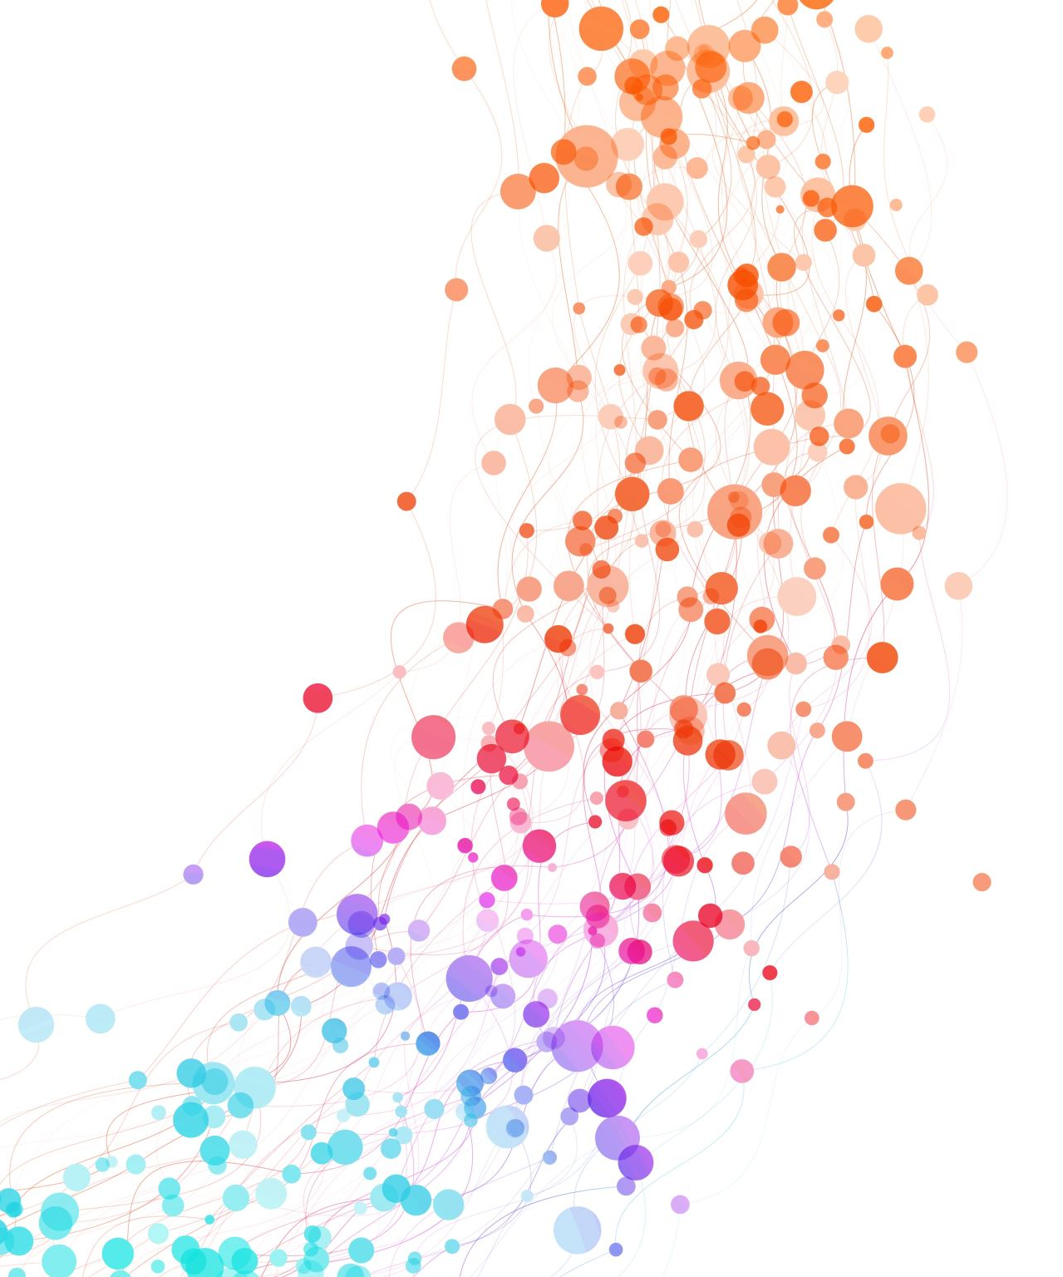
Observability with Grafana
For BPS – 20240710

Slide 2
Outline
Foundation of observability
01
Method of metric collection
02
Introduction to Prometheus
03
Introduction to Grafana
04

Slide 3
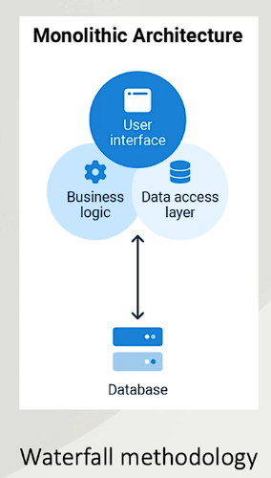
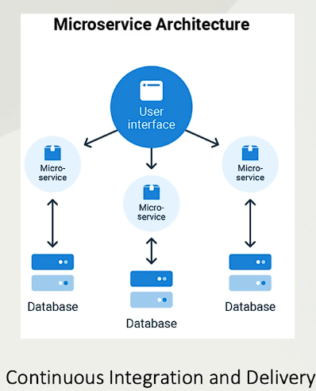
Foundation of observability
Why are CI/CD and Microservices Relevant to Observability?
Many services to monitor
Intra-service communication can fail
More changes are deployed

Slide 4
Foundation of observability
Three questions of monitoring:
Is the service on?
Is the service functioning as expected?
Is the service performing well?
The data that is collected for monitoring is called telemetry data.
Telemetry Data is used to find where the problem might be.
Metric used to measure the DevOps success:
Mean Time to Detection (MTTD)
Mean Time to Resolve (MTTR)

Slide 5
Foundation of observability
Methods of Monitoring:
UI Layer: Core Web Vitals
Largest contentful paint (page load time)
First input delay (responsiveness)
Cumulative layout shift
Service Layer: RED Method
Rate (throughput): request per second
Errors: failed requests (http errors)
Duration: latency/response time
Infrastructure Layer: USE Method
Utilization, i.e. CPU usage, storage usage
Saturation, i.e. network queue length
Errors, i.e. disk write error

Slide 6
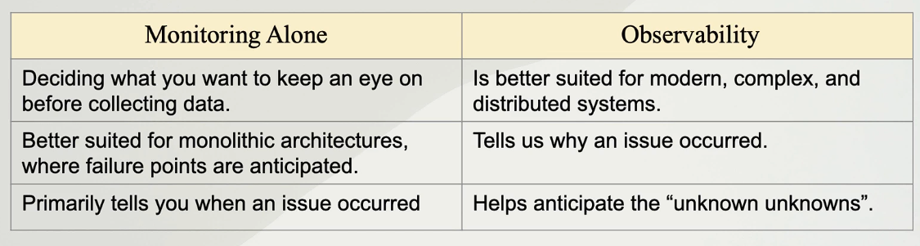
Foundation of observability
What is observability?

Slide 7
Foundation of observability
Type of Telemetry Data
Metric
Event
Log
Trace

Slide 8
Method of metric collection
Push Method:
Applications send the metrics to an endpoint via TCP, UDP, or HTTP.
Scrape Method:
Application provide APIs for the time series database to read the metrics.

Slide 9

Introduction to Prometheus
https://prometheus.io/
Prometheus is an open-source systems monitoring and alerting toolkit originally built at SoundCloud. Since its inception in 2012, many companies and organizations have adopted Prometheus, and the project has a very active developer and user community. It is now a standalone open source project and maintained independently of any company. To emphasize this, and to clarify the project's governance structure, Prometheus joined the Cloud Native Computing Foundation in 2016 as the second hosted project, after Kubernetes.
Prometheus collects and stores its metrics as time series data, i.e. metrics information is stored with the timestamp at which it was recorded, alongside optional key-value pairs called labels.

Slide 10

Introduction to Prometheus
Prometheus's main features are:
a multi-dimensional data model with time series data identified by metric name and key/value pairs
PromQL, a flexible query language to leverage this dimensionality
no reliance on distributed storage; single server nodes are autonomous
time series collection happens via a pull model over HTTP
pushing time series is supported via an intermediary gateway
targets are discovered via service discovery or static configuration
multiple modes of graphing and dashboarding support

Slide 11
Introduction to Prometheus
Data Model
Prometheus stores data as time series
Every time series is identified by metric name and labels
Labels are a key and value pair
Labels are optional
<metric name>{key=value, key=value, …}
Example: <auth_api_hit> {count=1, time_taken=800}

